Slide 1
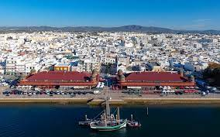
Harmful gases in Olhão

Slide 2
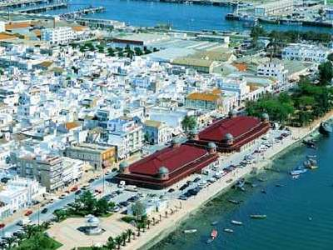
Pollution in Olhão
Olhão isn´t a very big city and isn’t very industrialized, so pollution is not such a serious problem as it is in other european cities.
Our pollution mainly derives from:
a sardine and tuna cannery;
an industrial laundry;
cars (diesel and gasoline).

Slide 3
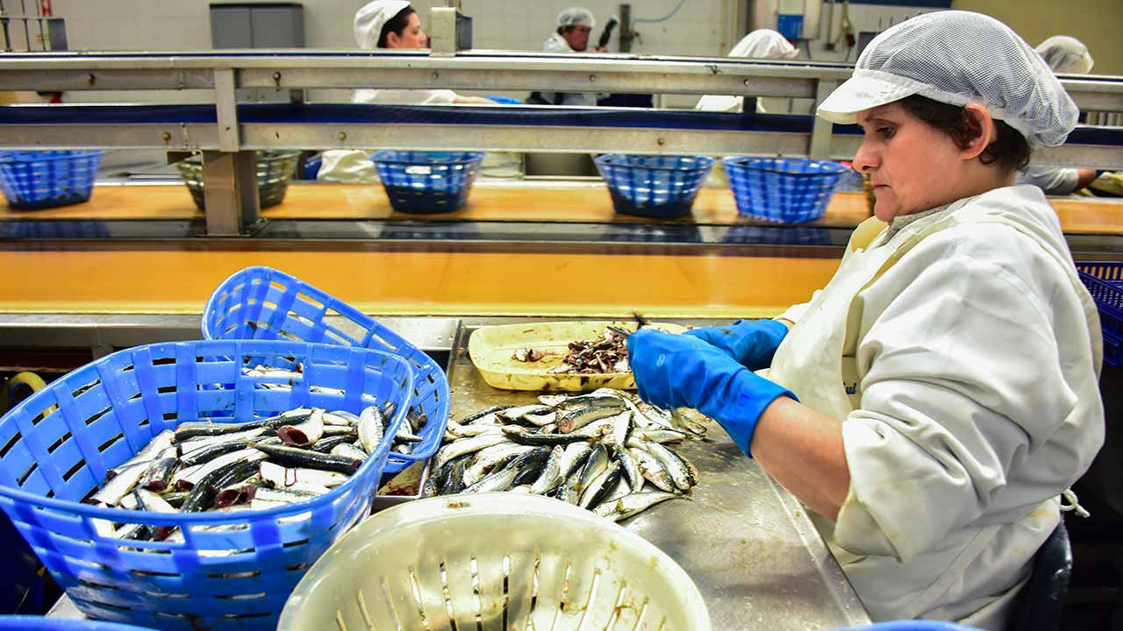
Harmful gases
The local sardine and tuna cannery produces sulfur, nitrous oxide, methane, carbon monoxide and carbon dioxide gases.
Some of these gaseous emissions cause a bad smell felt even in the outskirts of the city.

Slide 4
Harmful gases
The local industrial laundry complex emits microfibers into the atmosphere. Although they are not a gas, they are quite polluting. Some of these microparticles contain chemicals that are dangerous to health.

Slide 5
Harmful gases
Burning gasoline and diesel fuel, cars create harmful gases like nitrogen dioxide, carbon monoxide, hydrocarbons and benzene.
In addition, vehicles emit carbon dioxide, the most common human-caused greenhouse gas.

Slide 6
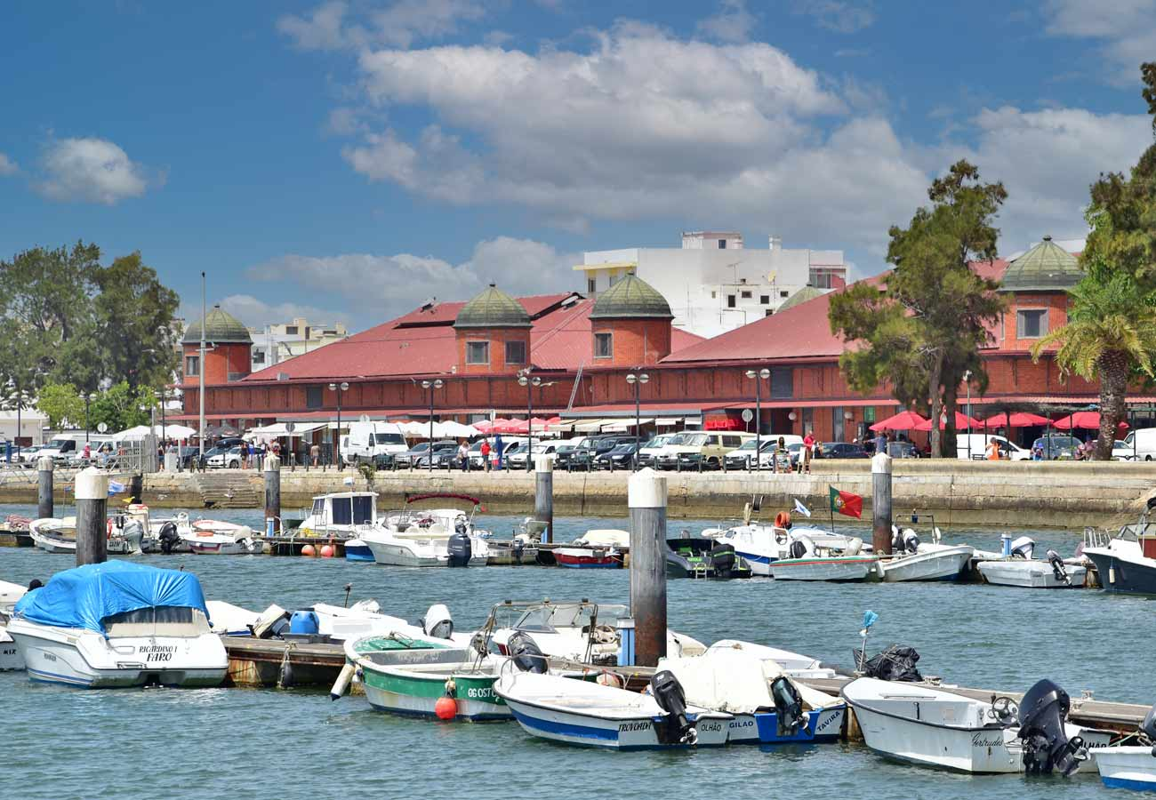
Preventive measures to combat pollution:
Sensors that measure air quality in high-traffic areas and which we can access through an APP;
Reinforce compliance with legal standards, referring to the emission of gases, by local industries;
Conditioned traffic in downtown city
during the weekend.

Slide 7
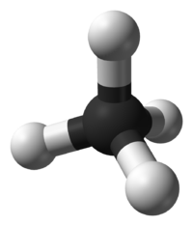
Harmful gases - current situation
Methane gas is our main concern at the moment because there are no institutions for its treatment and it is still released into the atmosphere.
This fact is of great concern to environmentalists as the comparative impact of methane on climate change is 20 times greater than that of carbon dioxide.

